Slide 1
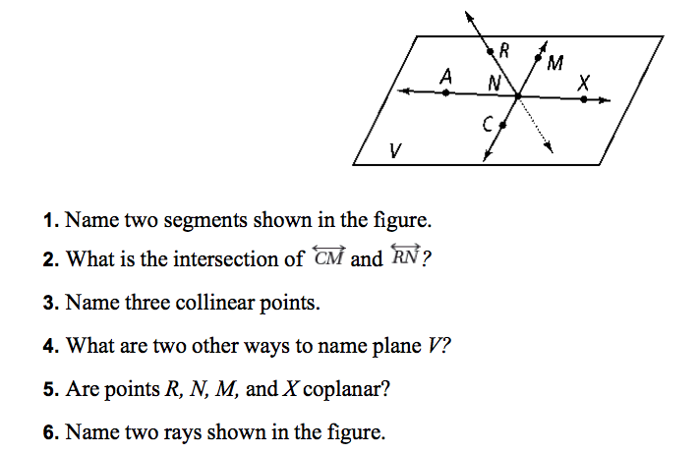
Warmup
Online Game

Slide 2
Measuring Segments
Chapter 1
Section 2
You can use Number Operations to find and compare the lengths of segments.
Common Core Standard: G.CO.1
Know precise definitions of angle, circle, perpendicular line, parallel line, and line segment based on the undefined notions of point, line, distance along a line, and distance around a circular arc.

Slide 3
Postulate 1-5: Ruler Postulate
Every point on a line can be paired with a real number. The real number that corresponds to a point is called the coordinate of the point.
The distance between two points is the absolute value of the difference in their coordinates. This value is the length of the line segment.

Slide 4
Example 1
What is ST?
Checkpoint:
What are UV and SV on the number line above?

Slide 5
Postulate 1-6 Segment Addition Postulate
If three points (A, B, and C) are collinear and B is between A and C, then AB + BC = AC
Example:

Slide 6
Example 2
If EG = 59, what are EF and FG?
8x – 14
4x + 1
E F G

Slide 7
Checkpoint
4x + 6
7x + 15
J K L
In the diagram, JL = 120. What are the lengths of JK and KL?

Slide 8
Congruent Segments
When two segments have an equal length, then the segments are congruent (≅) segments.
Are SU and TV congruent?

Slide 9
The midpoint of a segment is a point that divides the segment into two congruent segments.
Anything that intersects a segment at its midpoint is a segment bisector.
l
A
B
C

Slide 10
Problem 4
Q is the midpoint of PR. What are the lengths of PQ, QR, and PR?
6x - 7
5x + 1
P Q R
Is it necessary to substitute the value of x into the expression for QR in order to find the length of QR?

Slide 11
Partner Check
Turn to page 23 in your book.
With your partner answer questions 1- 7.
You have 10 minutes to complete this before we go over it.

Slide 12
Homework:
Pg 24
# 9-29 odd, 14, 26, 39-41

